Slide 1
Vendor C-CDA to FHIR mapping review and alignment

Slide 2
Worked Through with Vendors
(in May ballot)

Slide 3
Allergy

Slide 4
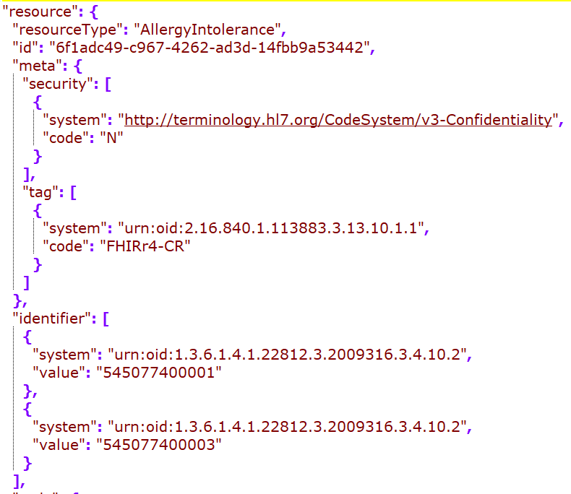
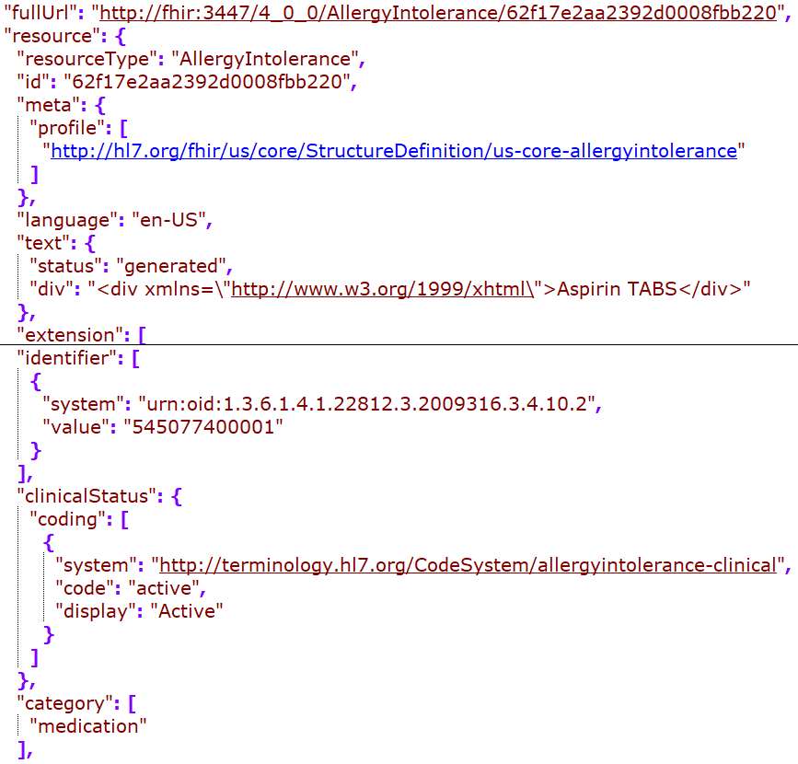
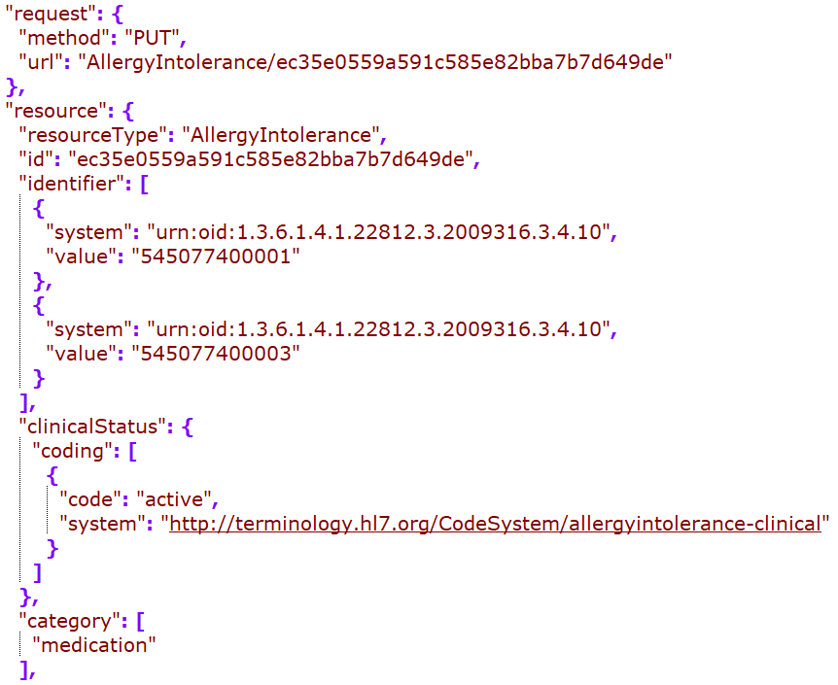
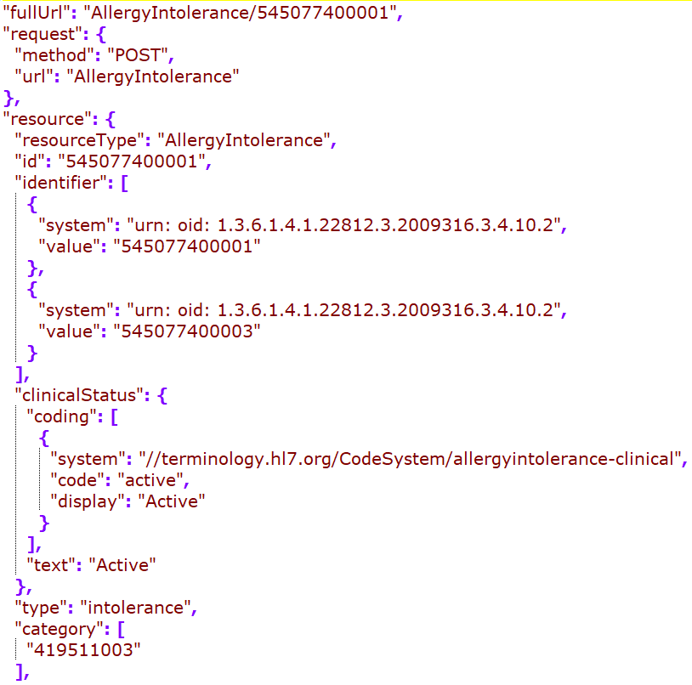
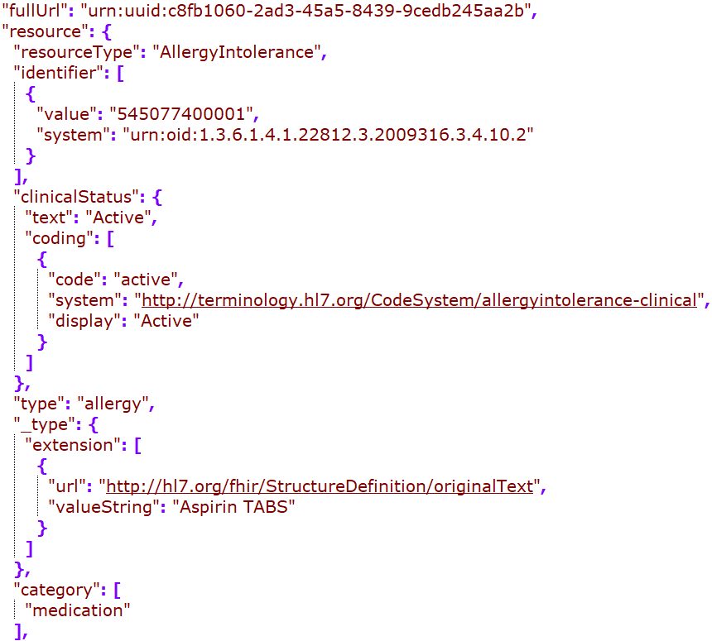
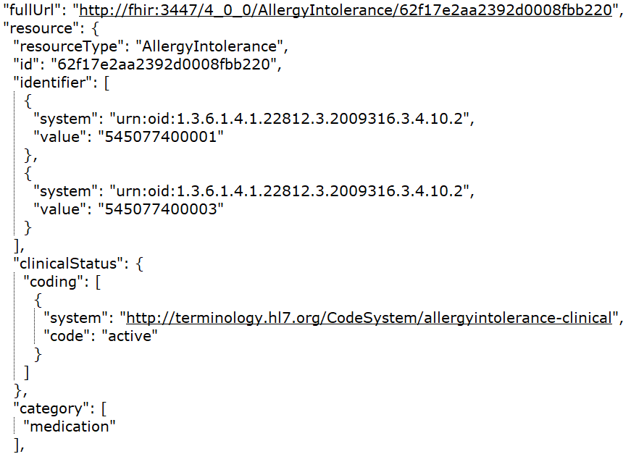
Cerner
DH
Google
MDIX
Redox
Rec in JSONC

Slide 5
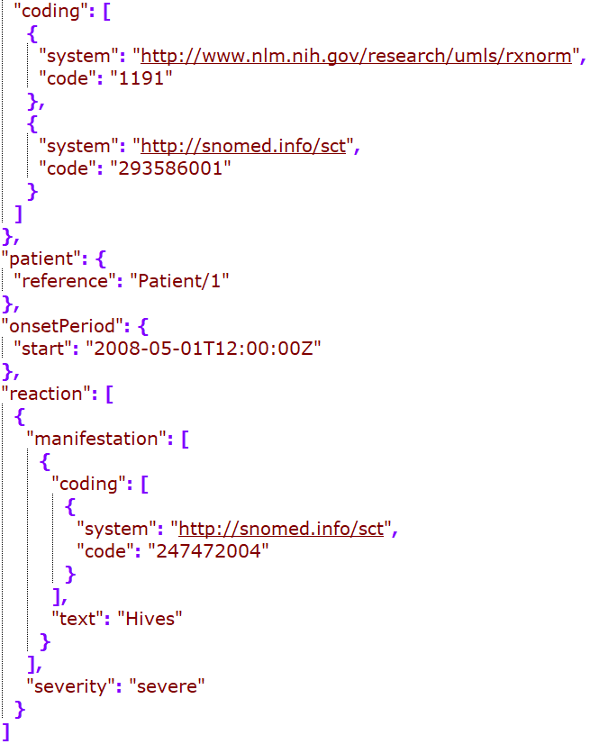
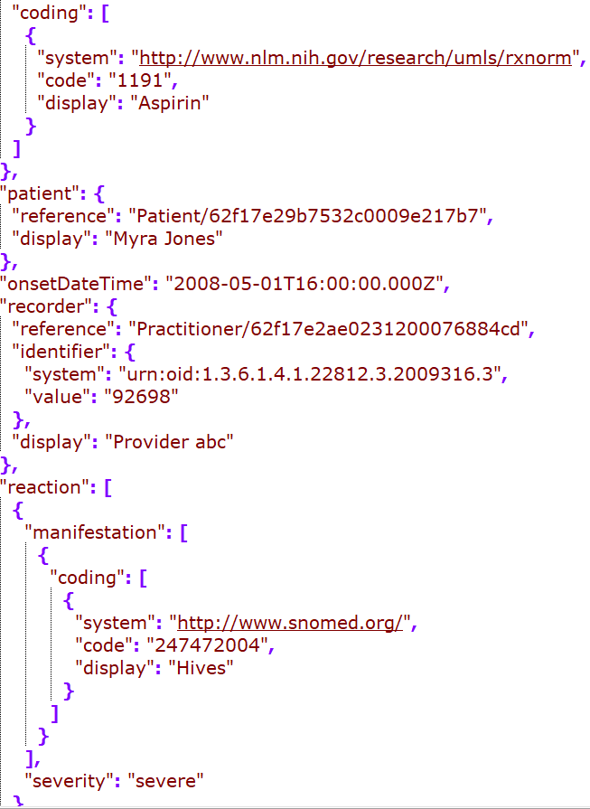
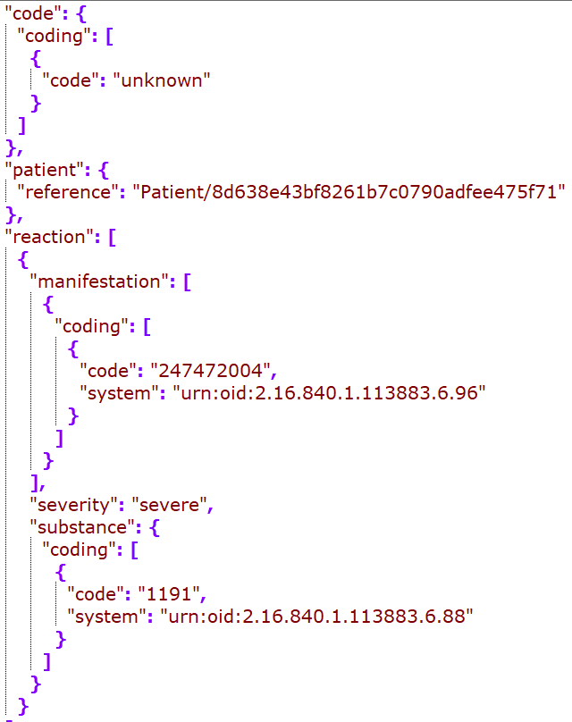
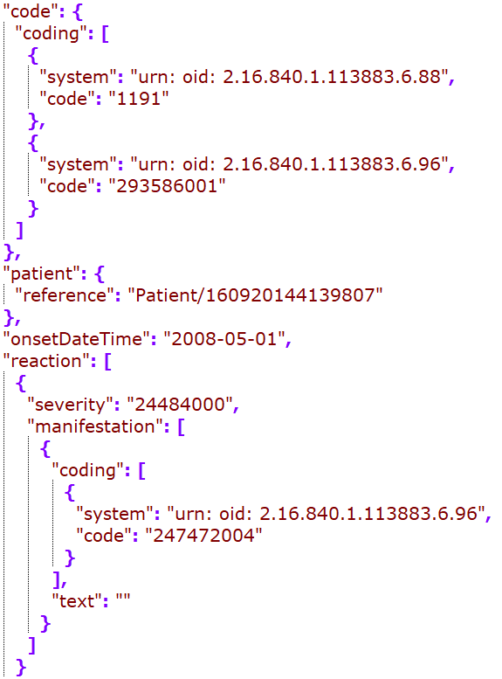
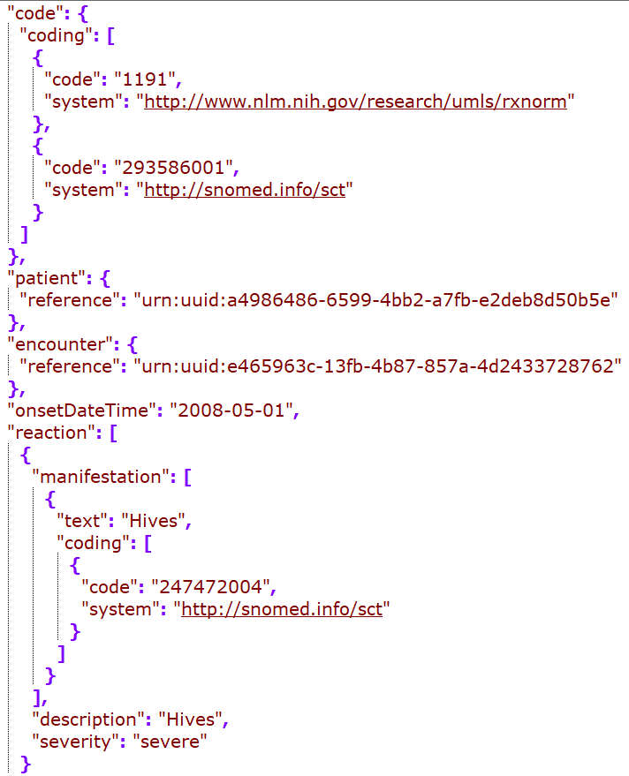
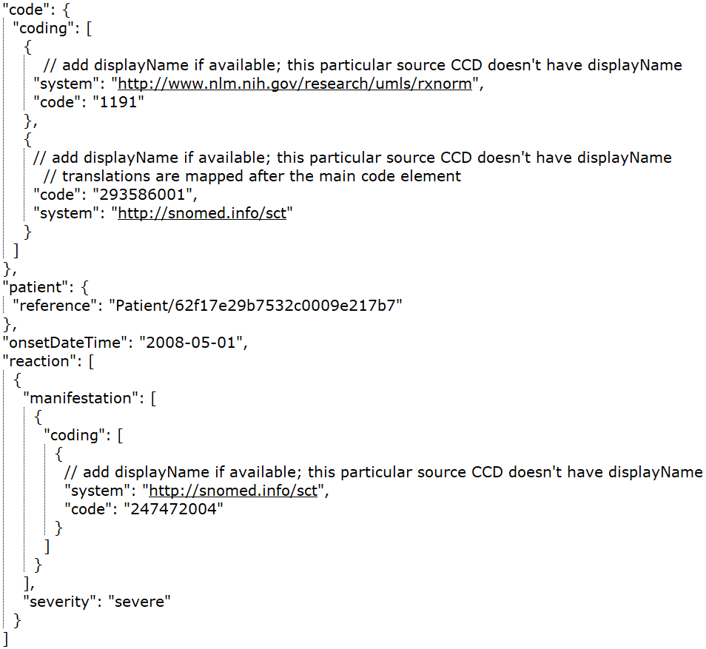
Cerner
DH
Google
MDIX
Redox
Rec – in JSONC

Slide 6
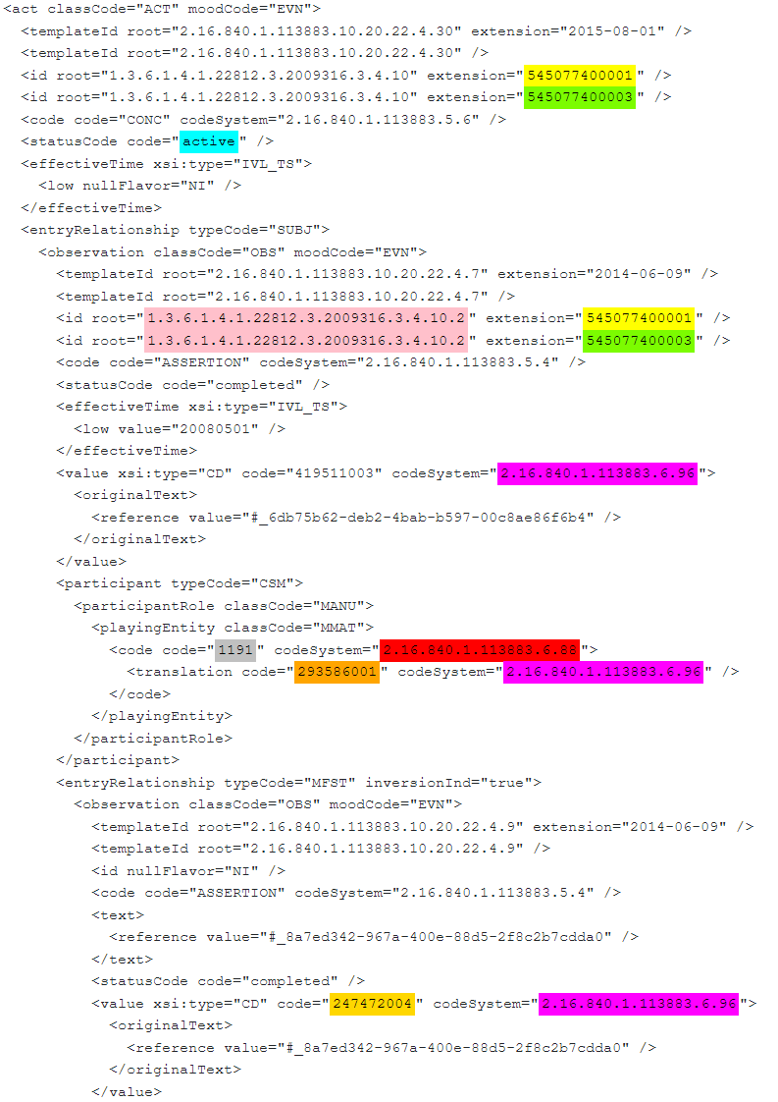
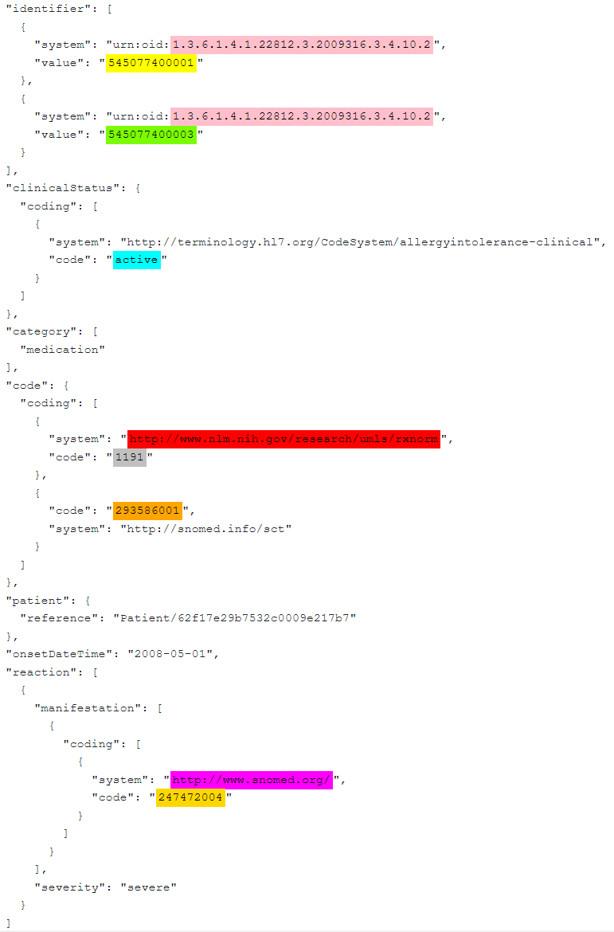
CCD – Allergy snippet
FHIR – Allergy snippet

Slide 7
Immunization

Slide 8
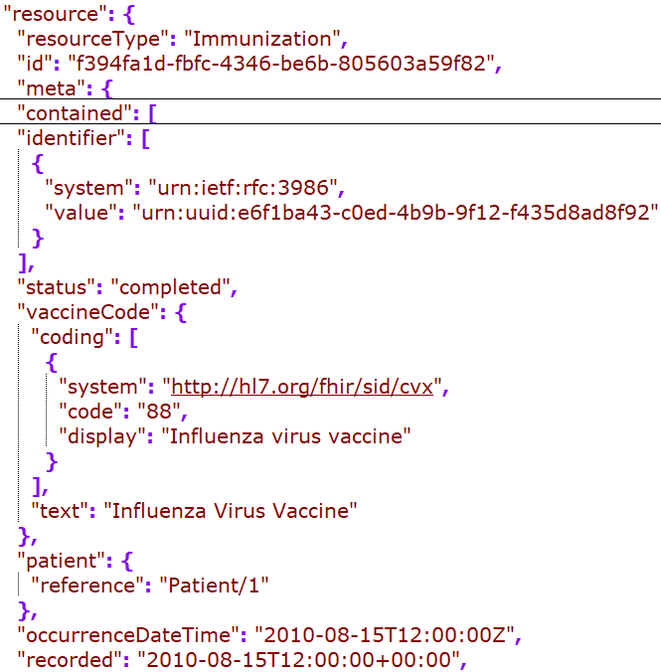
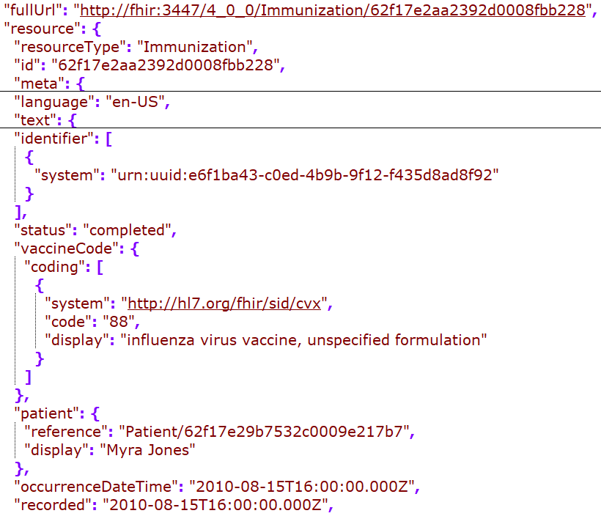
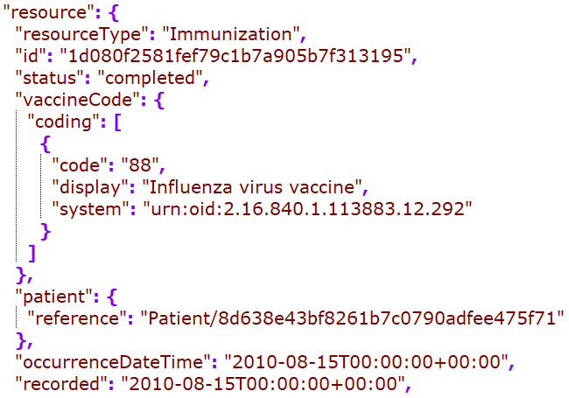
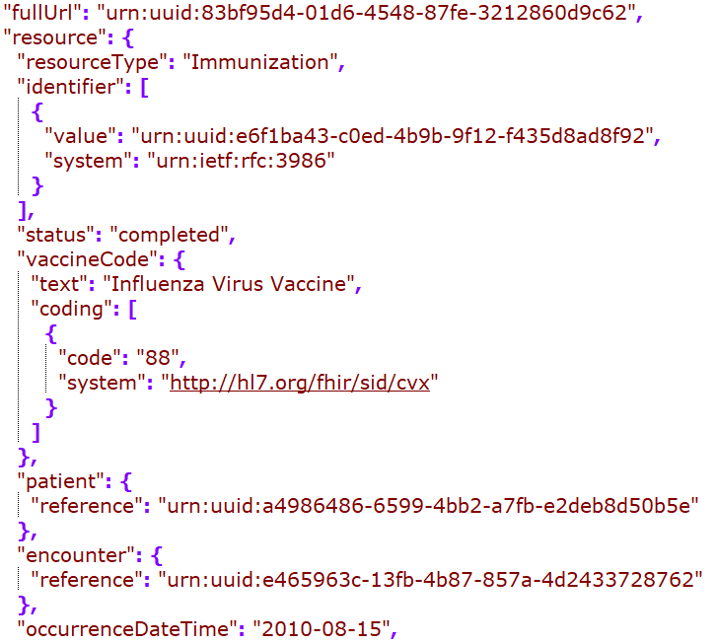
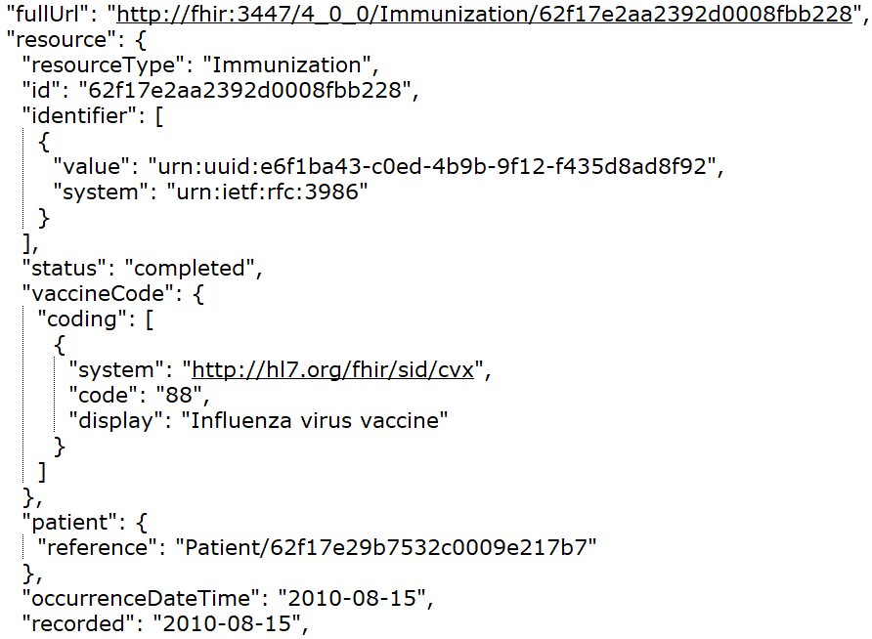
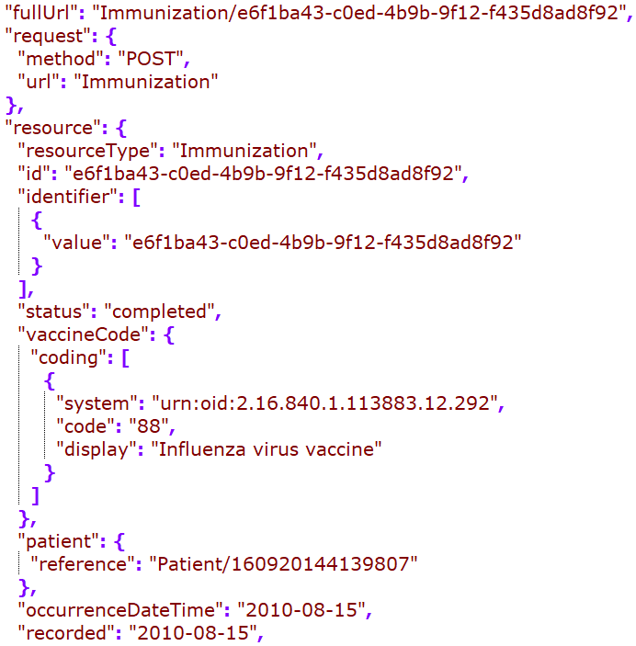
Cerner
DH
Google
MDIX
Redox
Rec – in JSONC

Slide 9
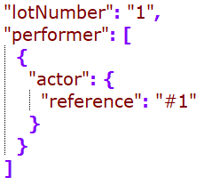
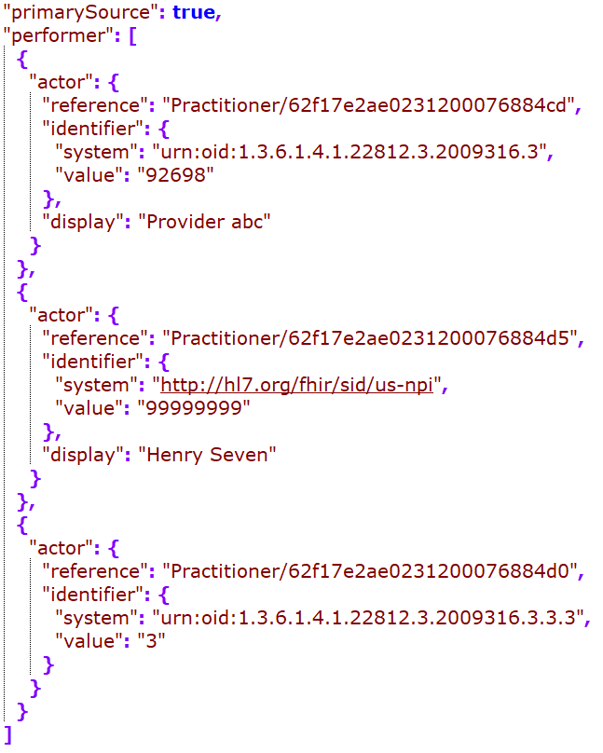
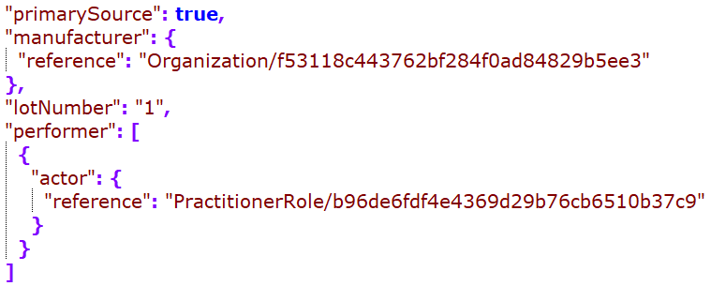
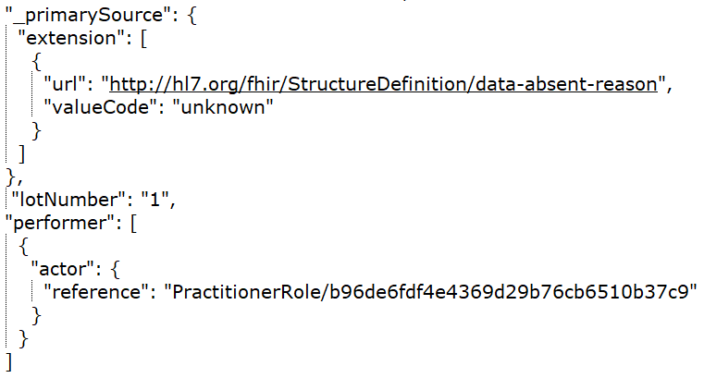
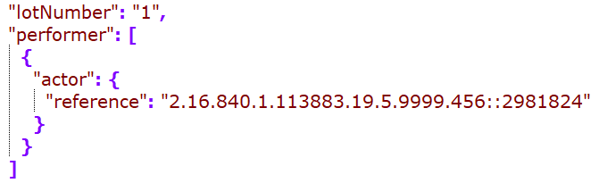
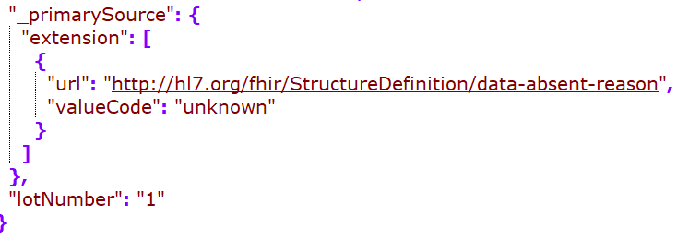
Cerner
DH
Google
Rec – in JSONC
MDIX
Redox

Slide 10
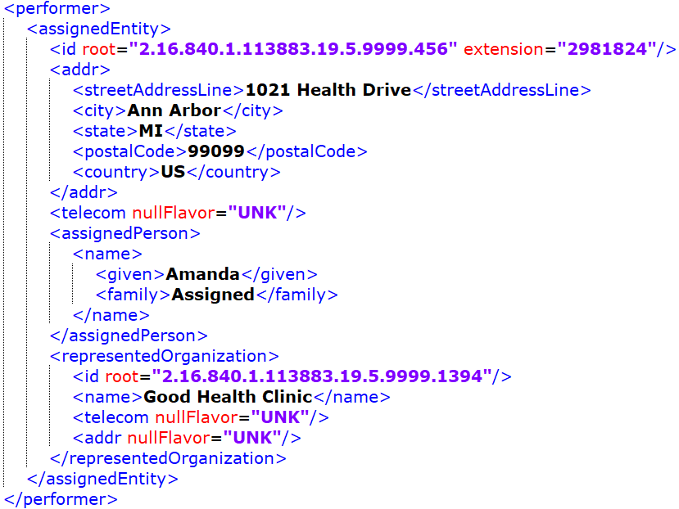
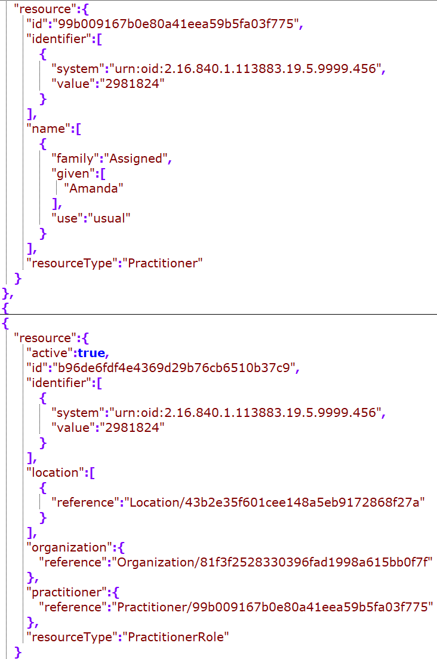
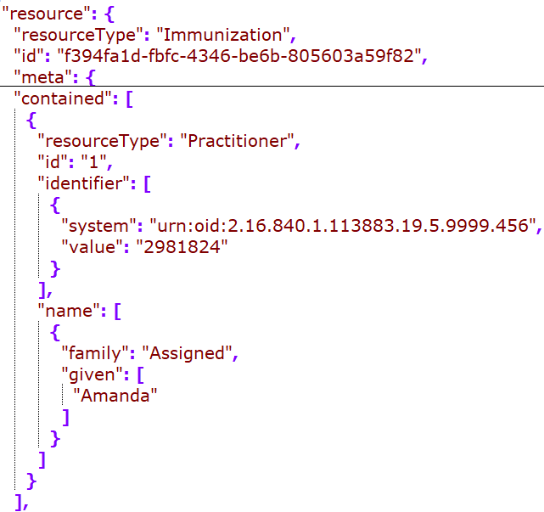
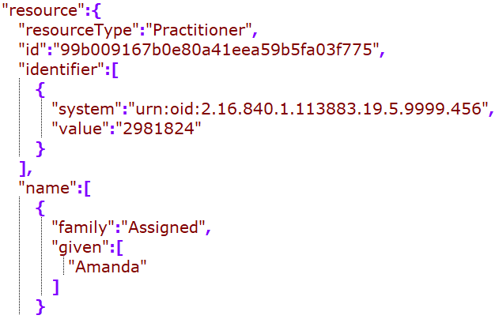
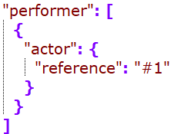
Practitioner (Immunization Performer)
Cerner: embedded in the clinical entry/ resource
Google: standalone resource
MDIX: didn’t find a match – should we recommend to resolve a reference within a composition?
Cerner/Google:
standalone vs embedded?
Practitioner or practionerRole as the direct reference

Slide 11
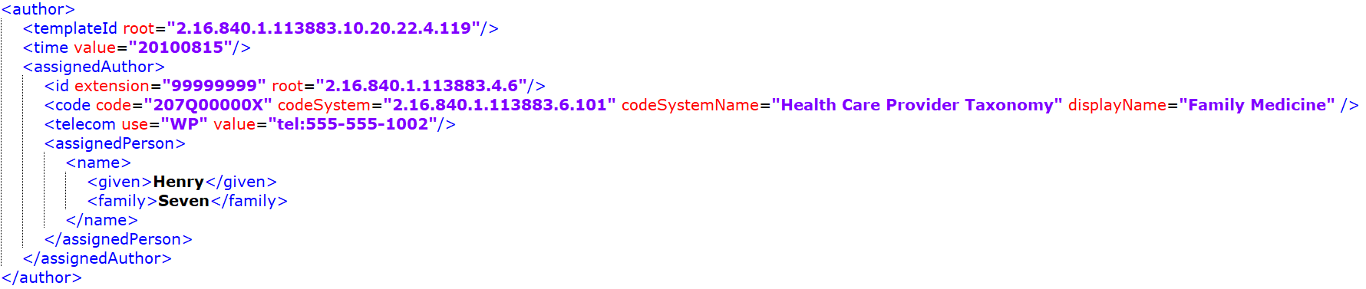
While performer is picked up by some, the author seems to be dropped from all mappings…
Since there is not “recorder” for the immunization resource, this could be mapped to provenance.

Slide 12
Patient

Slide 13
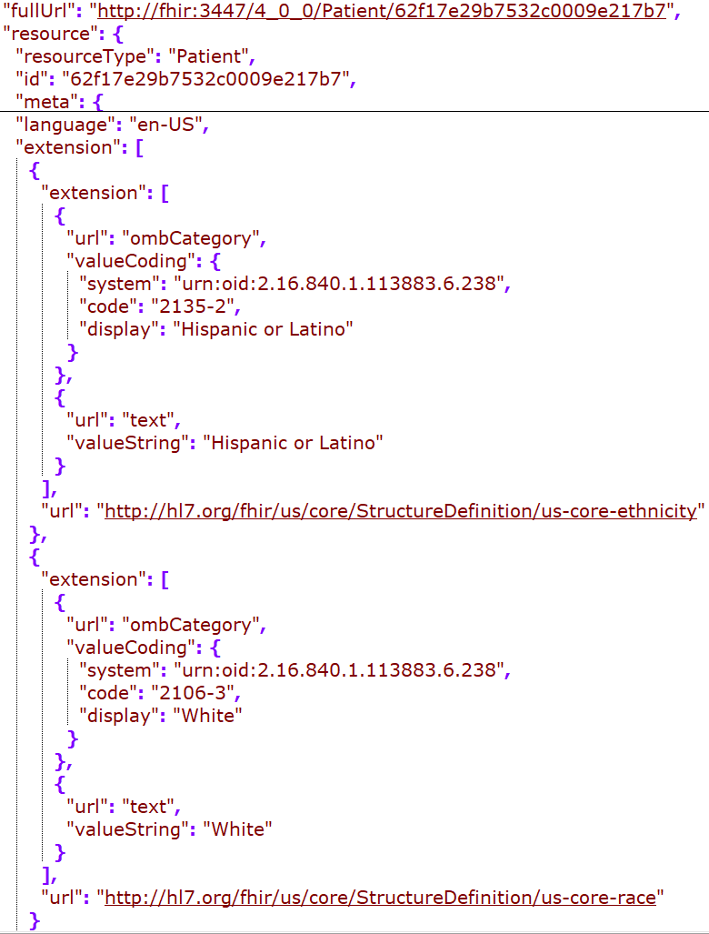
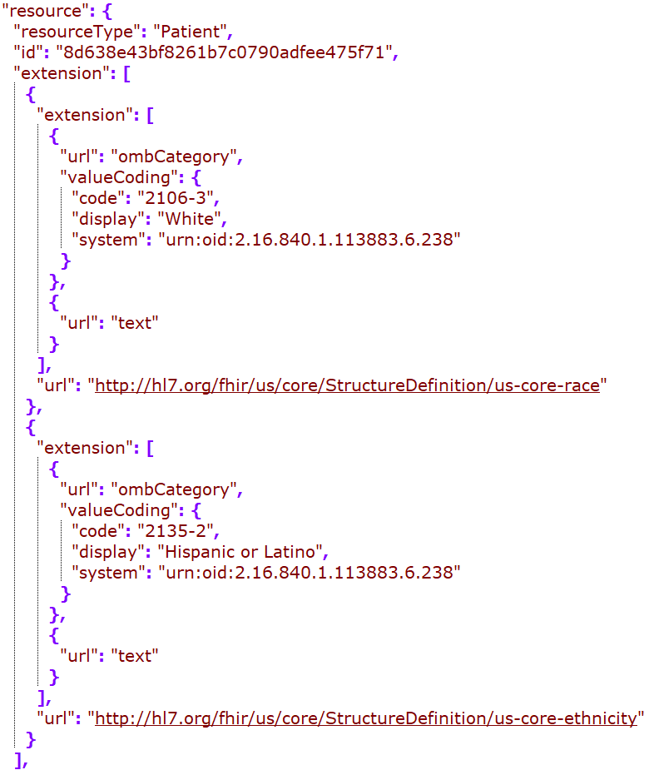
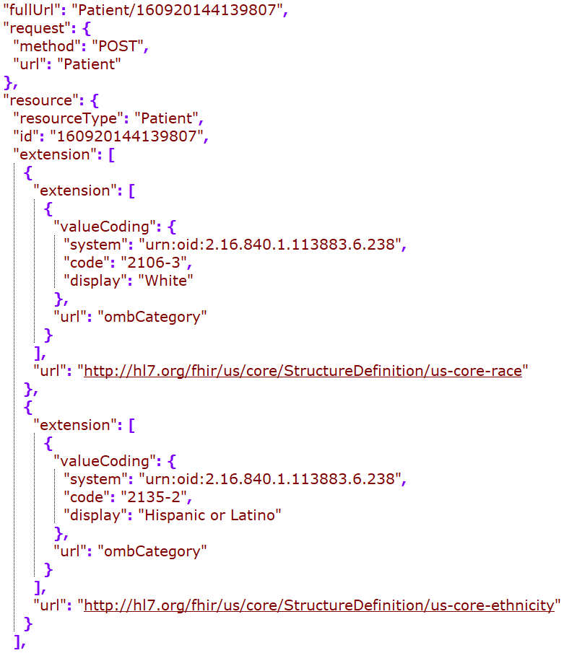
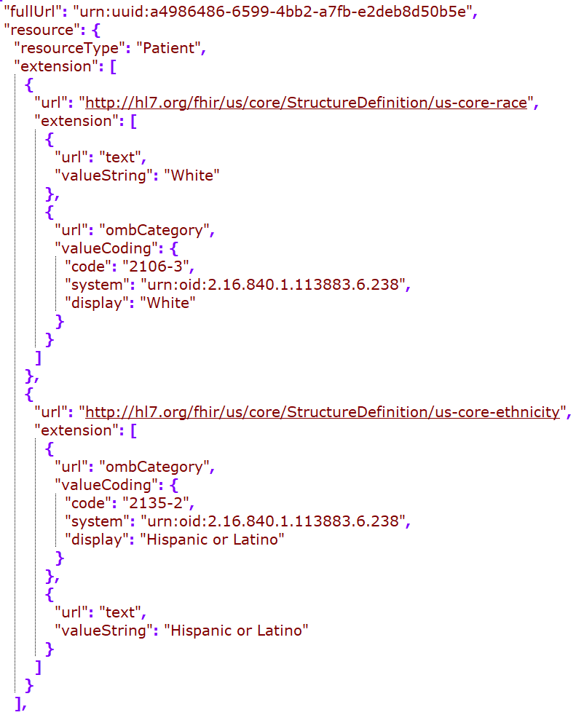
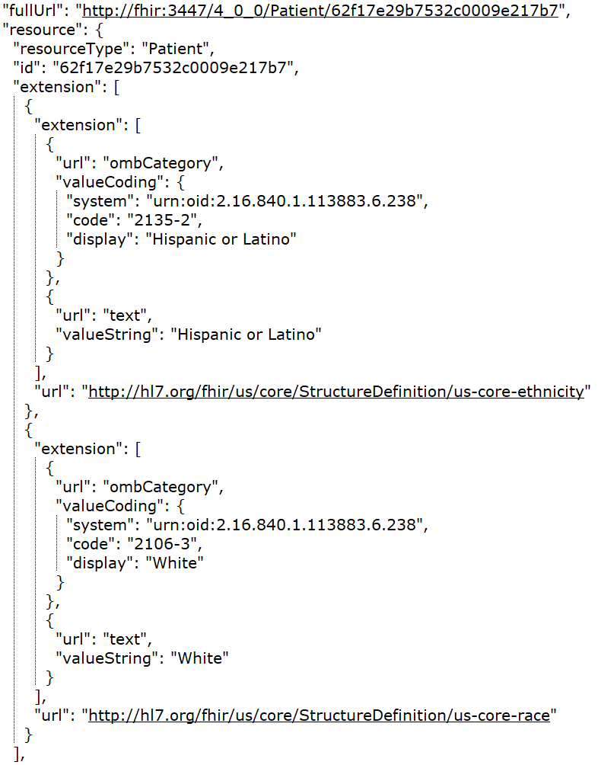
DH
Google
MDIX
Redox
Rec – in JSONC

Slide 14
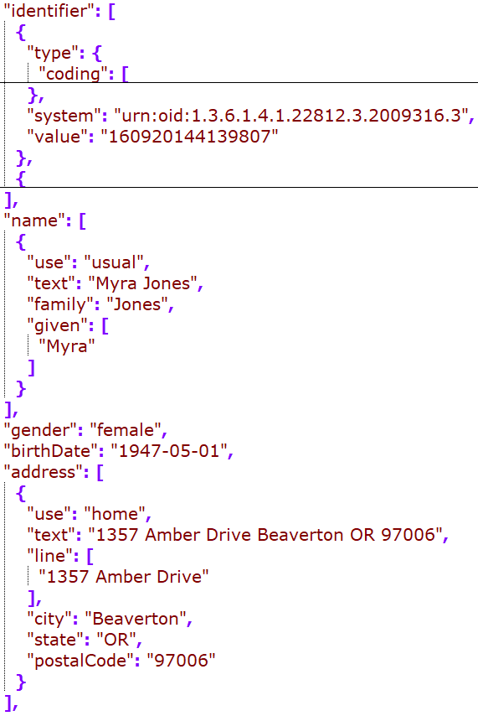
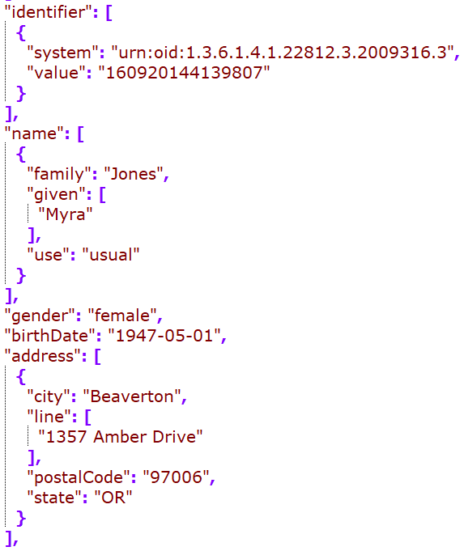
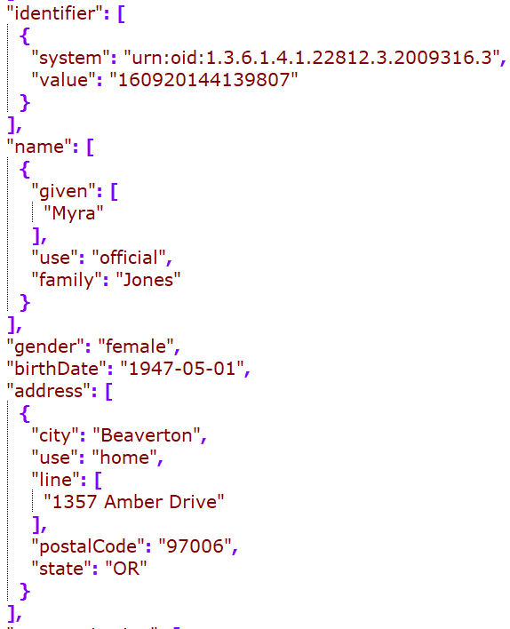
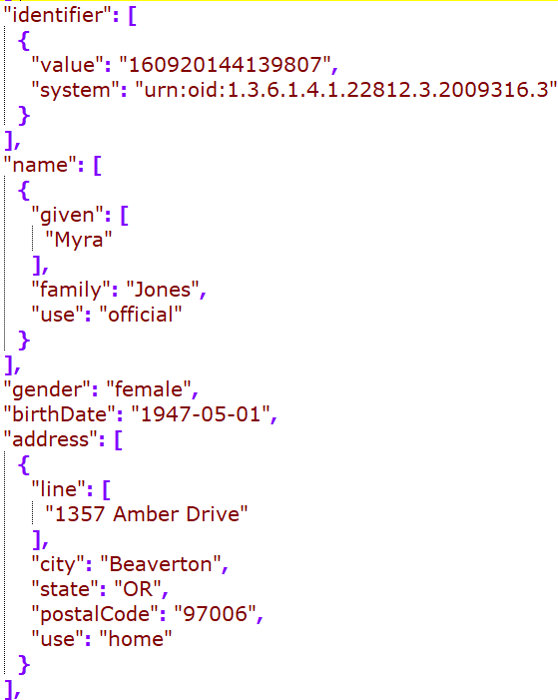
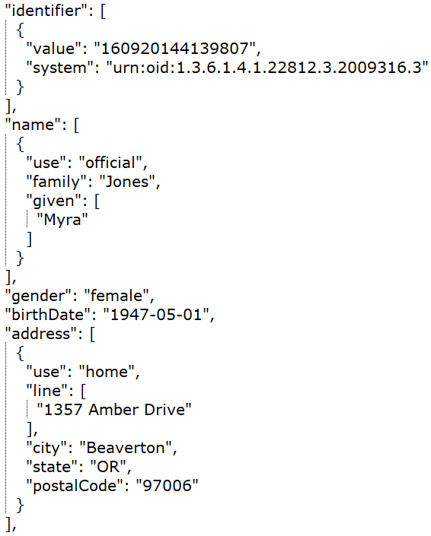
DH
Google
MDIX
Redox
Rec – in JSONC

Slide 15
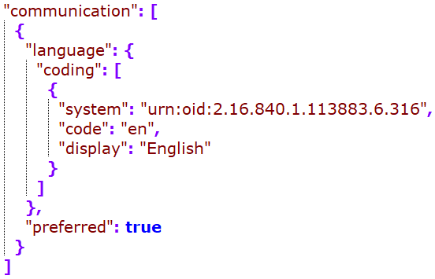
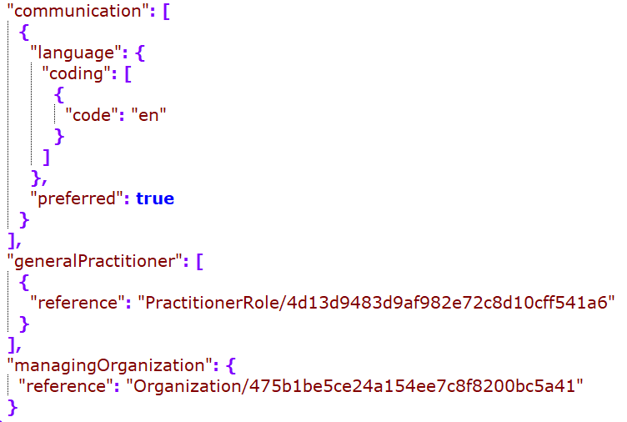
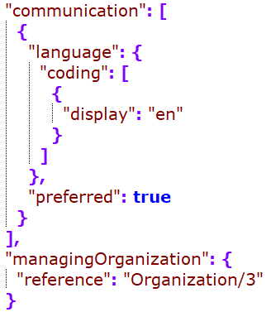
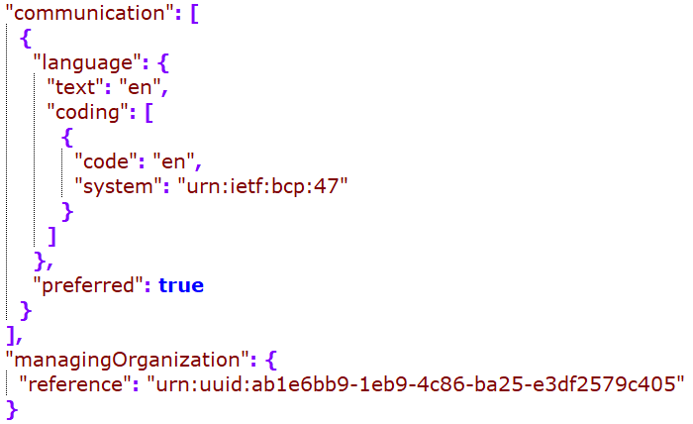
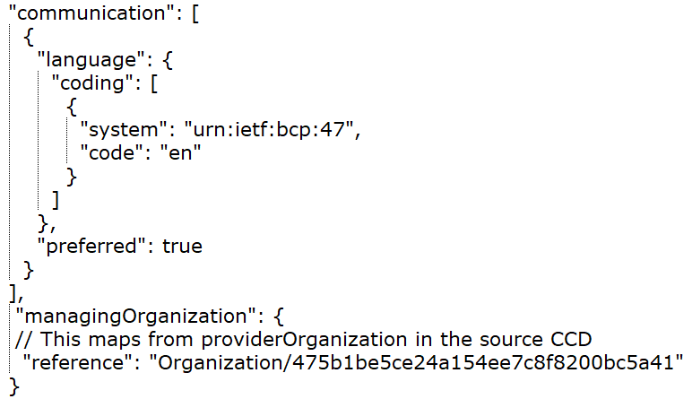
DH
Google
MDIX
Redox
Rec – in JSONC

Slide 16
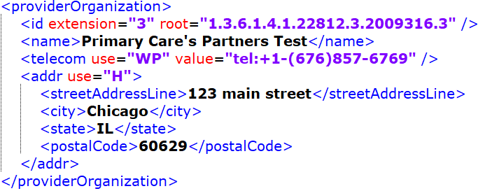
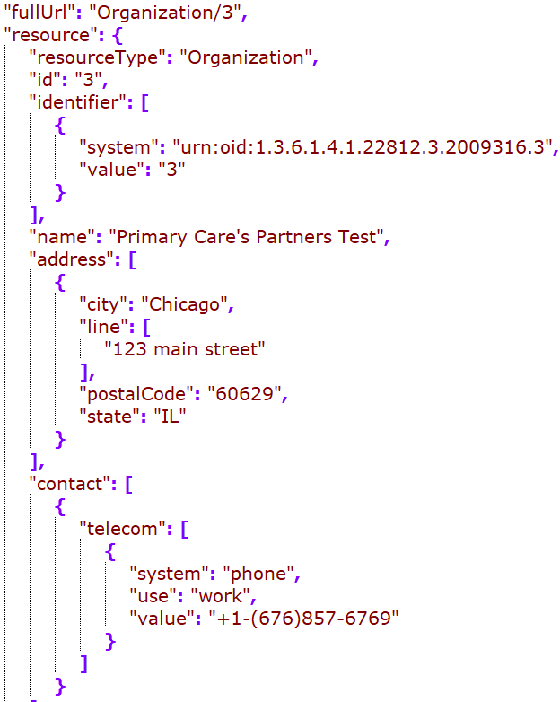
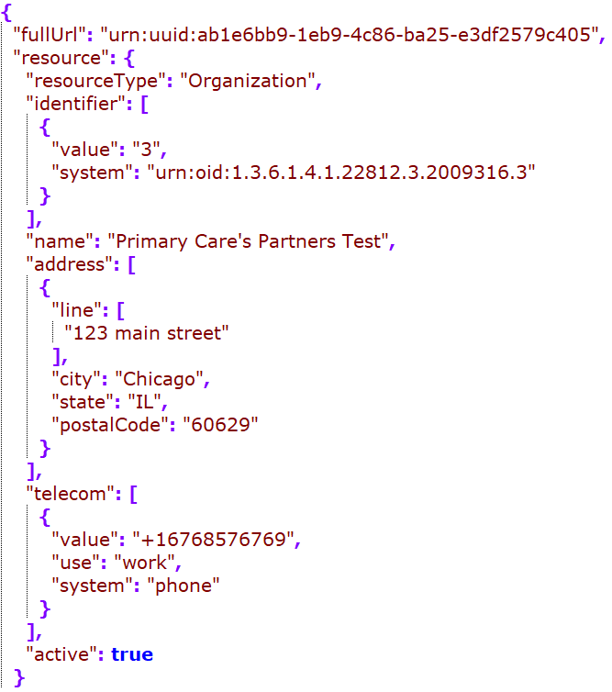


Organization (providerOrganization)
Google
MDIX
Redox
Rec

Slide 17
Problem

Slide 18






Cerner
DH
Google
Rec – in JSONC
MDIX
Redox
Notes:
Id dedupe?
Category including the actual code (a retired SNOMED code for problem), or problem-list-item (looks like this is required)

Slide 19






Cerner
DH
Google
MDIX
Redox
Rec – in JSONC
Notes:
Observation timestamp – mapped to onsetDateTime or onsetPeriod.start
Map the act timestamp?

Slide 20
Medication -
Mapping to medicationRequest for all medication entries
May also map to other medication resources as needed, but the map is out of scope of this project
The following slide compared medicationRequest mapping

Slide 21



Cerner
DH
Rec

Slide 22
Outstanding Questions as of 12/21/2022
Medication mapping by moodCode
Practitioner or practionerRole as the direct reference
practionerRole should be the direct reference
When not available, use the practitioner
Creating practitionerRole only when the practitioner has a code, or the data has an organization and a person
Organization: telecom format
FHIR examples have all different formats, all numbers, with parathesis, beginning plus signs, etc. may want to go with minimal manipulation? Detect the type and use that to direct where to go for FHIR data attributes and map the rest of the strings.
“mailto”: email, fax: - fax, sms: - sms, tel: - phone (or if use="PG", then "pager")
If none of the above and it contains a “@”, map to “email”
Otherwise, map to “phone” with the string as is
Nullflavors mapping
standalone vs embedded – recommending standalone
Best practice is to include resultable reference in the composition – where would this go?
Notes:
Same practitioner in two facilities, one is billable and not; they need to be separate
Organization or code/functionCode needs to be available to map

Slide 23
nullFlavor mapping
nullFlavor from C-CDA to nullFlavor
If it’s required, map to the DAR using Jay’s map
If it’s not required and the flavor is one of UNK, NI, NA, drop it
If it’s not required, there are options. A lot of misuse of nullFlavors in the C-CDA (cite the paper?), choice can be made based on your implementation, trust of the source data quality, etc.
Choices are: drop all; drop when they are one of UNK, NI, NA, and map others using Jay’s map; map all using Jay’s map
Jay’s maps:
https://docs.google.com/spreadsheets/d/1InSFh9f8WILzz4J3IB_QaXQUGNYSiAtOjEtwK3FkswI/edit#gid=827428488
https://docs.google.com/spreadsheets/d/1VWVtLyuQdZq-EZ020nndAIhfAIVjVqAUG-rUhh9ZX2s/edit#gid=0
See updated guidance in the next two slides

Slide 24
nullFlavor mapping - Non-coded data elements
Non-coded data elements map to DAR extensions
Required data elements
Map to the relevant-flavor DAR (using the map)
Use “unknown” DAR if there are no applicable mappings
Optional data elements – options below
Map to relevant DAR; Use “unknown” DAR if mapping is not available
Map to relevant DAR for flavors other than “NI”, “UNK” and “NA”; drop if it’s one of these three
Drop all
Guidance in non-italic font is summarized from: http://hl7.org/fhir/us/core/STU3.1.1/general-guidance.html#missing-data
Guidance in Italic font is from project group’s best practice recommendation

Slide 25
nullFlavor mapping - Coded data elements
Non-coded data elements generally map to DAR code with the DAR URI as codeSystem
Required data elements
Required binding:
Use the appropriate “unknown” concepts in the value set if available
If not available, create a 404 http error if it’s one of the five elements defined by the USCore*
If not available and not one of the given elements above, map to a DAR extension, using Jay’s map
Other binding:
Use code or text if available
If not, map to the DAR code (using the map), and use “unknown” if mapping is not available
Optional data elements – options below
Map to relevant DAR code; Use “unknown” DAR if mapping is not available
Map to relevant DAR code for flavors other than “NI”, “UNK” and “NA”; drop if it’s one of those
Drop all
Guidance in non-italic font is summarized from: http://hl7.org/fhir/us/core/STU3.1.1/general-guidance.html#missing-data
Guidance in Italic font is from project group’s best practice recommendation
* All the 5 elements are statuses, which may be able to be derived from related data elements such as effectiveTime, moodCode, etc.
Notes:
AllergyIntolerance.clinicalStatus
Condition.clinicalStatus
DocumentReference.status
Immunization.status
Goal.lifecycleStatus

Slide 26
Handle mapping the nullFlavor section??
Only required for the required clinical sections
If the section has NI as the nullFlavor, do not map to FHIR resource
No known allergy
https://build.fhir.org/ig/HL7/US-Core/StructureDefinition-us-core-allergyintolerance.html
Available for higher level concepts (class level) – use a concept map if there are no specific allergen code but has an allergy type in the C-CDA
For negation for a specific allergen, no standard way to do on the FHIR side – could ask on Zulip
DH was mapping that to the LOINC code (48767-8) of “annotation” and specific allergen code to the annotation. Comment

Slide 27
General Mapping Recommendations:
For codable concepts, map the originalText from the C-CDA to the coding.text attribute (using the reference link as needed to obtain the actual text before mapping)
For codable concepts with translations, map the translations to coding.code array, following the main entry
For identifier mapping, please refer to https://docs.google.com/spreadsheets/d/1EhRiTh3-wOd6t0eQa2iKD4RQ-A32aqNju1R0rG-afgE/edit#gid=2143847847 for the full mapping logic 4.
Within a bundle, should always try to include resultable reference links

Slide 28
Other Reference Resources in P+PAMI

Slide 29
Procedure

Slide 30






DH
MDIX
Redox
Rec
Google
Notes:
Change to a single value and map to performedDateTime

Slide 31
To Discuss with Vendors
(Not in May ballot)

Slide 32
Result

Slide 33


Source Lab Results entry
Inbound CCD Results Entry

Slide 34
Result - Observation

Slide 35






C
D
G
M
R
Rec
Notes:
ResourceType, identifier, status: same mapping across vendors
Category coding:
map from inbound section template? (most mapped)
Also map the “text” field?
Consensus: to use the LOINC parts to direct the mapping to the category coding; infer from the section (but not everything is going to be laborotary; ask C-CDA to include the guidance)

Slide 36






C
D
G
R
M
Rec
Notes:
Cerner/Google/MDIX: how they map results.issued?
From Previous recommendation:
Coding:
Map to http://loinc.org as the system
Map the xml originalText to the “text” field
effectiveDateTime: no need to supplement timestamps
Patient Ref: include display? - no
Encounter ref: include?
”issued”: whether and how to map?
subject: if you have the link to the referenced resource, do not have to include the display; otherwise try to include the display
“issued”: if entry author.time is available, map from there; otherwise leave it out (check to make sure it’s after the onset date); need to pad with the timestamps

Slide 37






C
D
G
Rec
M
R
Notes:
Performer mapping:
Map if available in the observation level; otherwise leave it out
valueQuantity mapping:
Map to value and unit. If the unit is UCUM conformant, then also map to system and code.
referenceRange mapping
Map to value and unit. If the unit is UCUM conformant, then also map to system and code.
Need the quantity-precision ext?
Need “text”? Have to resolve the ref link
Recommendation: 1. recommend to FHIR to include precision as a field for the quantity field (quantityPrecision for quantity); 2. in the here and now, include the precision extension

Slide 38
Result - diagnosticReport

Slide 39



D
R
Rec
Notes:
ResourceType, status: same
Identifier: DH’s mapping??
Category: whether and how to map? Source LOINC/template?
Code: “display” is missing from source
3 codes: diagnostic imaging, laboratory, clinical, - find the loinc codes

Slide 40



D
R
Rec
Notes:
New questions/issues not covered before:
Logic for “issued”
What else to include in the performer, if more than “reference”?
Results reference to also include ”display”?
issued: map from the organizer author time if available. need to pad with the timestamps. otherwise DAR

Slide 41
Vital Sign

Slide 42


Source Vital sign entry

Slide 43






C
D
G
M
R
Rec
Notes:
ResourceType, identifier, status – same mapping
Category:
map “userSelected”? How? – not going to map
How to map to “text”? – not needed

Slide 44






C
D
G
Rec
M
R
Notes:
Code is the same
effectiveDateTime: mostly the same
map the single timepoint to the effectiveDateTime; and map the high low to effectivePeriod structure if the low and high are different
have to map to system and code for the specific vital signs

Slide 45

One vendor also mapped to an additional Observation resource to represent the vital sign panel
Notes:
http://hl7.org/fhir/R4/observation-vitalsigns.html
map the organizer to this vitalsign panel resource: see the link above
encounter conduction: for observation (results and vitals): safe to do so – encompassingEncounter
probably safe to conduct encounter to Note too

Slide 46
Social History

Slide 47


Source Social History entry
Notes:
Code.text mapping: if the reference points to more than one row, how should the “text” be structured? How did Redox map?

Slide 48





D
G
C
D
G
Rec
M
R
M
R
Notes:
Aligned on resourceType and category mapping
Status concept map – most mapped from “completed” in source to “final”, with 1 mapped to “registered”

Slide 49




D
G
R
C
D
G
Rec
M
R
M
Notes:
Should we map the source author to target performer? DH and google is doing that, but not Redox
Should the value be mapped to valueCodableConcept standalone, or to a component wrapper that also include the code?

Slide 50
Encounter

Slide 51


Source Encounter entry

Slide 52





C
D
G
Rec
R
Notes:
source has status of “completed” – map to “finished”?
Class – original code, high level (v3 act code) or orign

Slide 53





C
D
G
R
Rec
Notes:
Participant-
include type? Map to v3-ParticipationType or just text?
what else to include for the “individual” property?
reasonCode?
diagnosis?

Slide 54
Encounter Diagnosis Parsed to Condition Resource

Slide 55




DH
MDIX
Rec – in JSONC
Redox
Notes:
Id mapping?
Identifier?
Should we have clinical status? Optional and not provided on the diagnosis ER

Slide 56




DH
MDIX
Rec – in JSONC
Redox
Notes:
Map the observation effectiveTime to onsetDAteTime?
How is the DH’s recordedDAte mapped?
MDIX’s evidence?

Slide 57
Notes

Slide 58


Source Note entry

Slide 59



D
R
Rec
Notes:
identifier doesn’t appear to be available from source – DH derived?
Type
Category – clinical note is the only value in that value set: http://hl7.org/fhir/us/core/STU5.0.1/ValueSet-us-core-documentreference-category.html

Slide 60



D
R
Rec
Notes:
date – how to map?
map to custodian or author? – is DH mapping from doc level?
contentType – mimetype https://build.fhir.org/ig/HL7/US-Core/StructureDefinition-us-core-documentreference.html
period has the substructure of start and end rather than low and high: http://hl7.org/fhir/R4/datatypes.html#Period

Slide 61
Plan of Treatment

Slide 62


Source Encounter entry

Slide 63
Only two vendors have mapped – one to “goals” and the other to “serviceRequest”. Aligned on the last Connectathon it should be mapped to goals when it is a goal observation.

Slide 64



Slide 65



